Slide 1

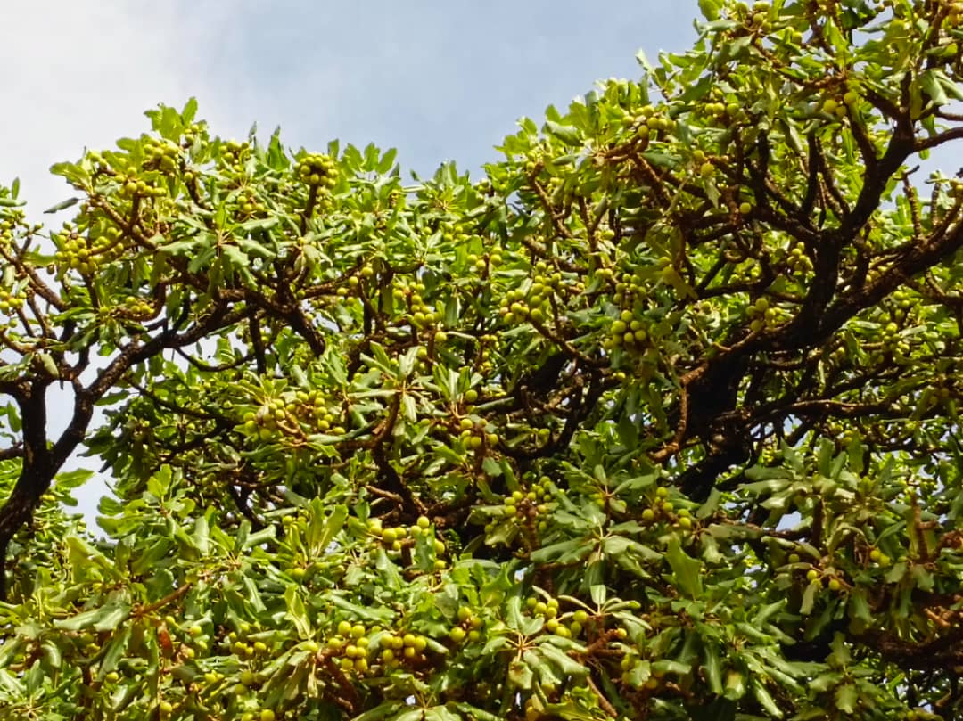
BLESSED ORGANIC

Slide 2
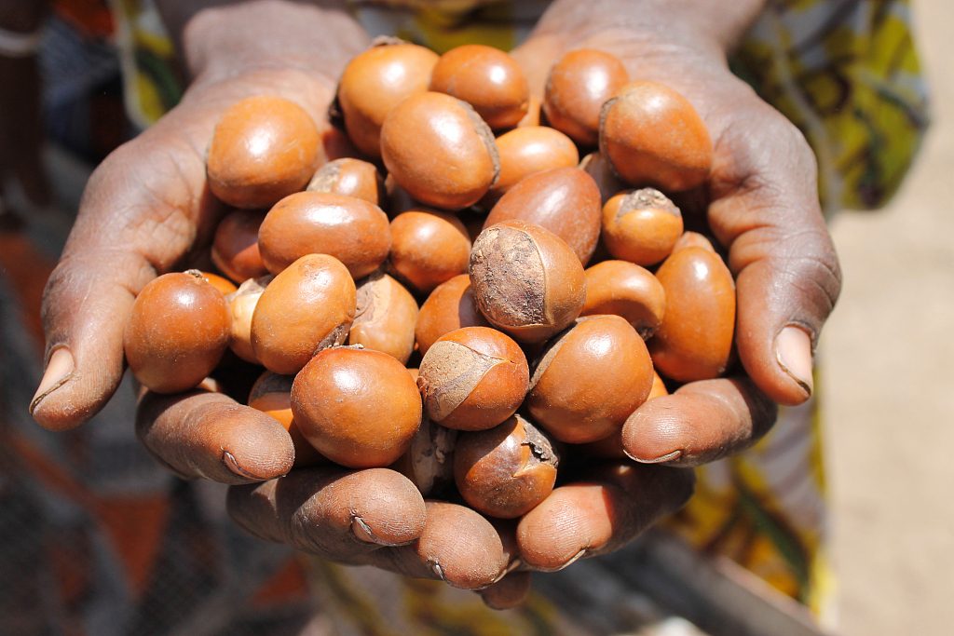
BLESSED ORGANIC
Blessed Organic specializes in producing and selling 100% organic Nilotic skincare products, with a primary focus on pure Shea butter sourcing from sustainable and ethical practices.

Slide 3
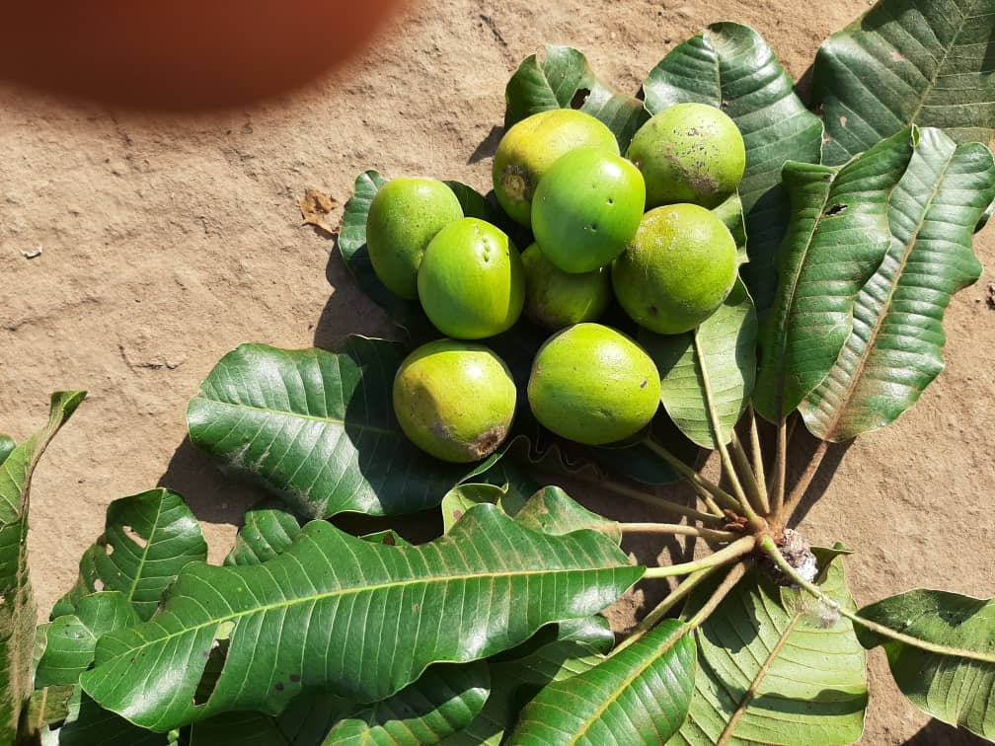
BLESSED ORGANIC
Problem Statement
Increased saturation of low quality uncertified shea butter with fillers & additives without traceability

Slide 4
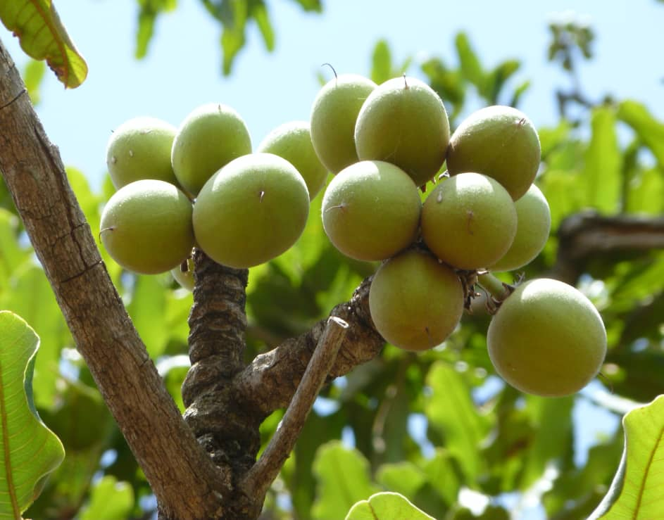
BLESSED ORGANIC
Solutions
01.
02.
To produce an authentic Pure Natural Organic Nilotica shea butter
Consistent quality
03.
Supporting ethical practices & traceability

Slide 5
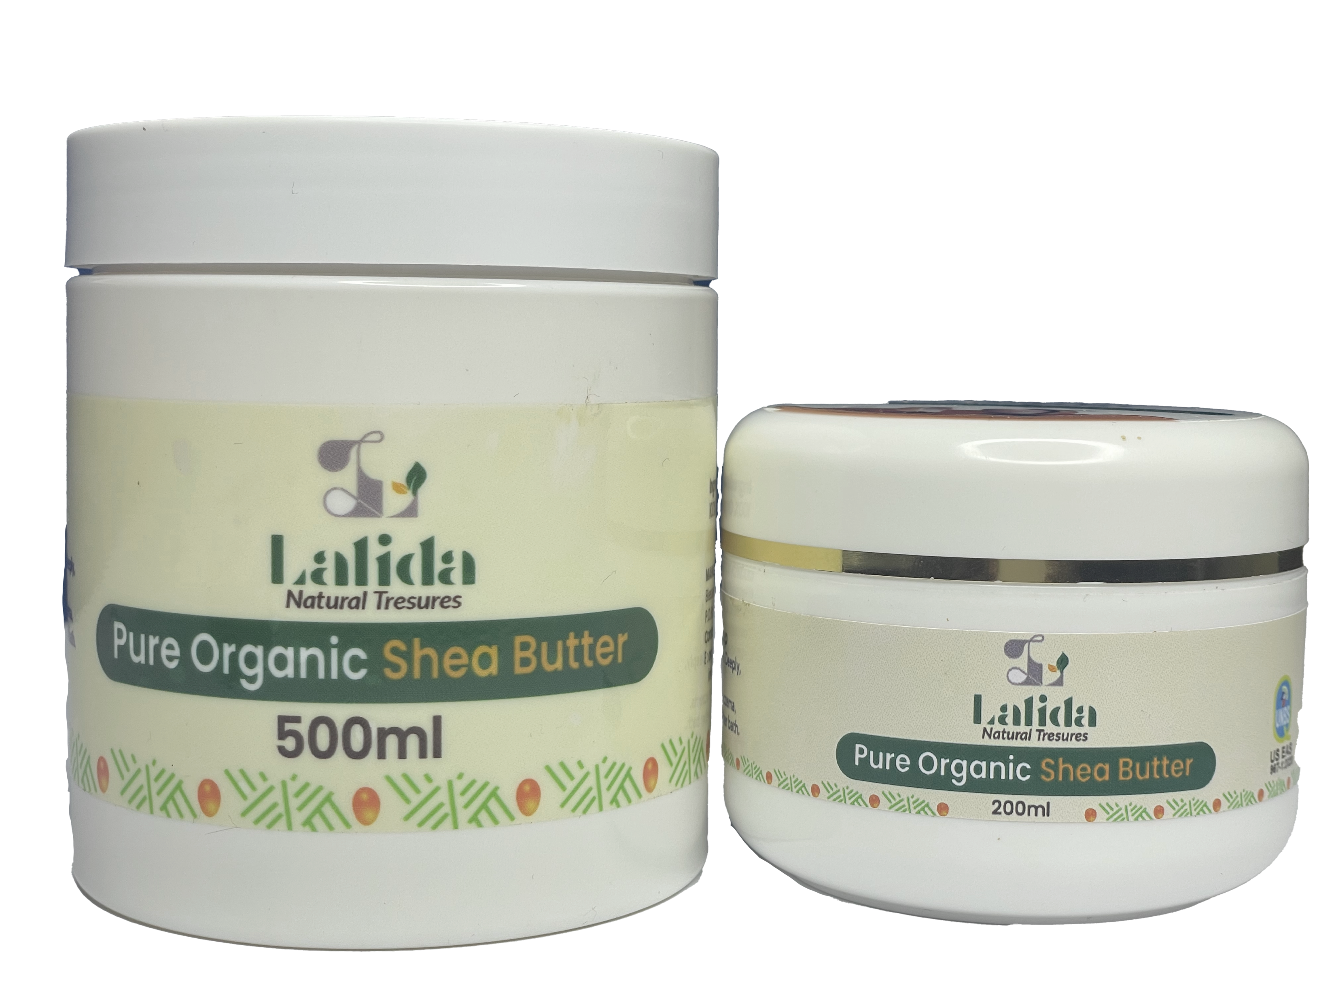
BLESSED ORGANIC
Products
Raw unrefined Nilotica Organic shea butter

Slide 6
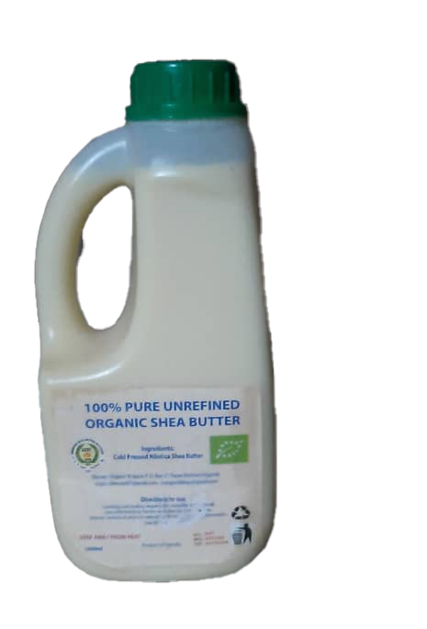
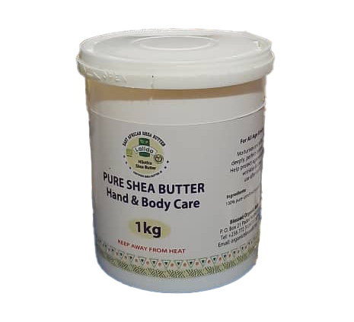
BLESSED ORGANIC
Products
Raw unrefined Nilotica Organic shea butter

Slide 7
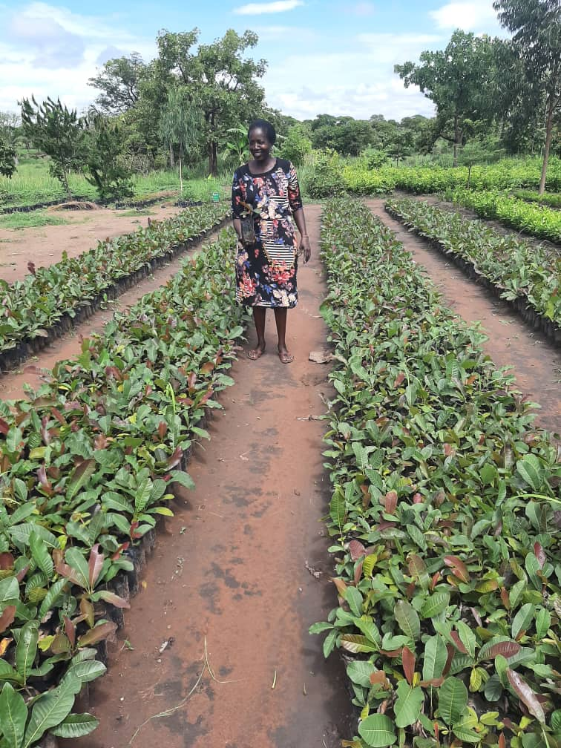
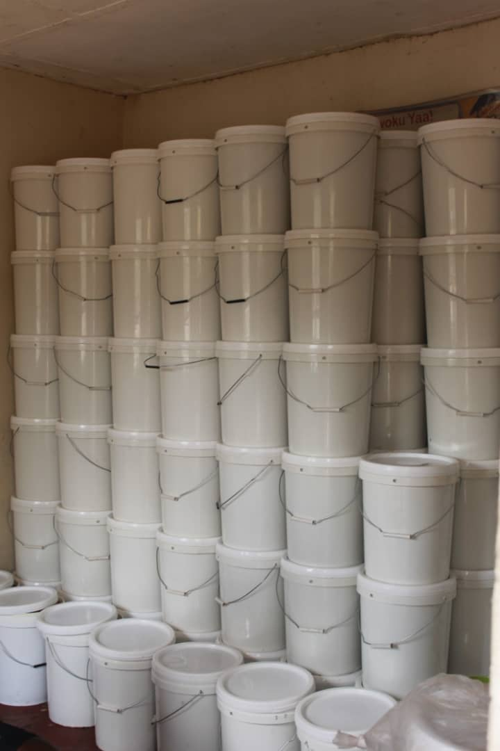
BLESSED ORGANIC

Slide 8





BLESSED ORGANIC
Business Model
Sourcing
Processing
Packaging & Labeling
Transporting
Distribution

Slide 9
BLESSED ORGANIC
Market Size
t
Market Opportunity
10%
Global Market size
$2.3B

Slide 10
BLESSED ORGANIC
Traction
Product | 2020 | 2021 | 2022 | 2023 | 2024 | 2025
Organic Shea Butter | 4tons | 5tons | 8tons | 12tons | 20tons | 38tons
Amount | $20,000 | $25,000 | $52,000 | $108,000 | $200,000 | $530,000

Slide 11
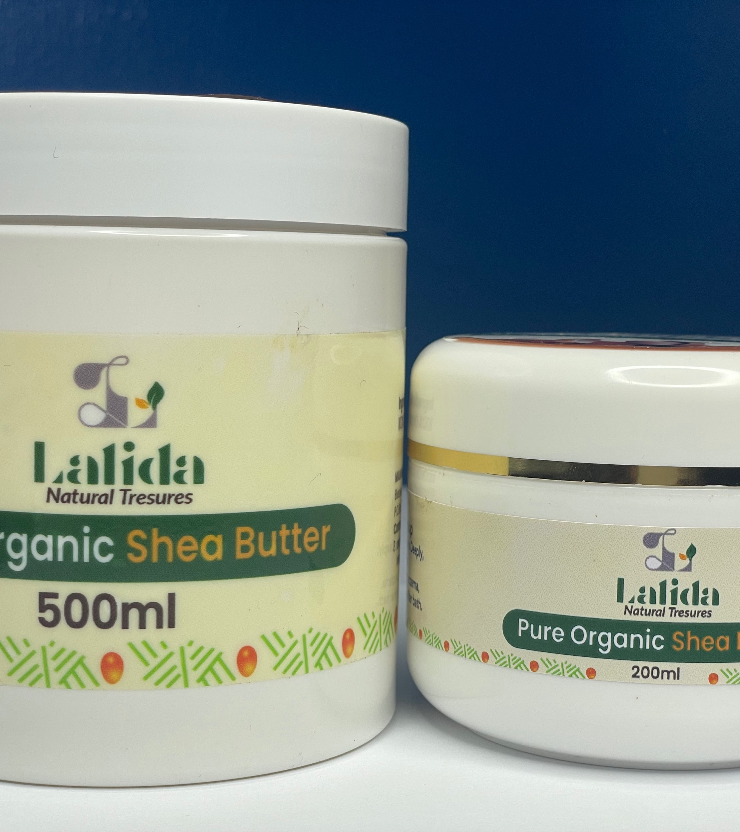



BLESSED ORGANIC
Our Certifications

Slide 12
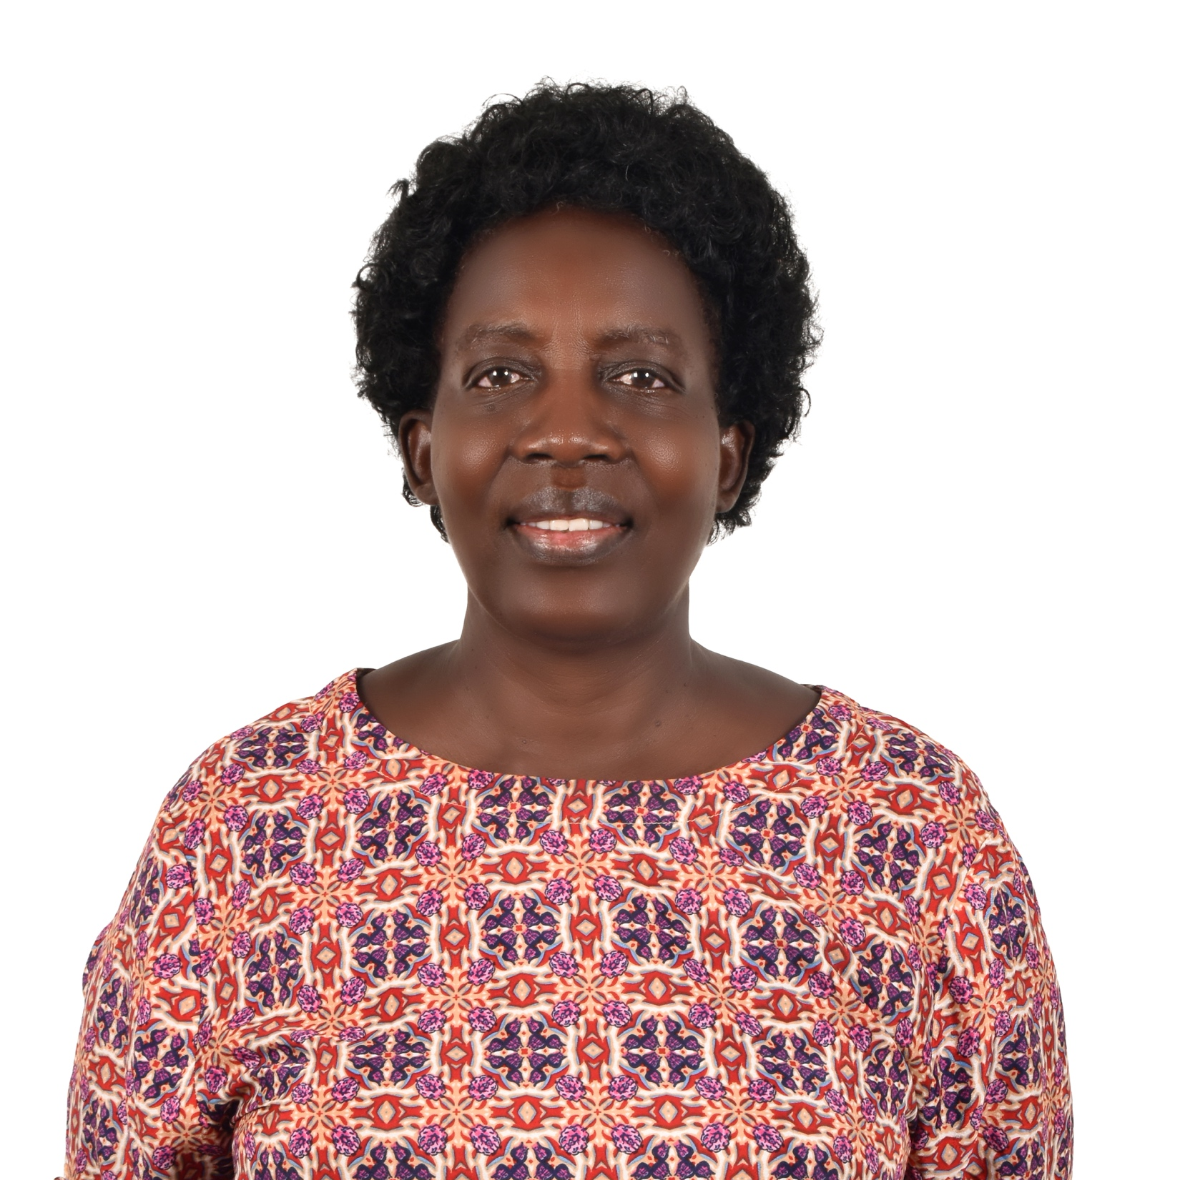
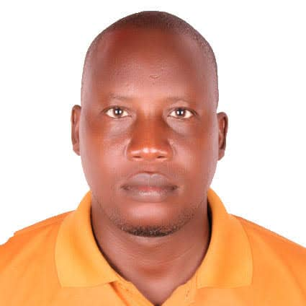
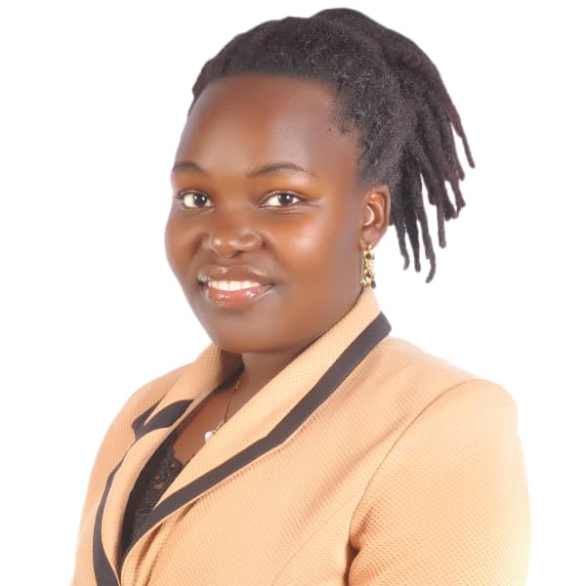
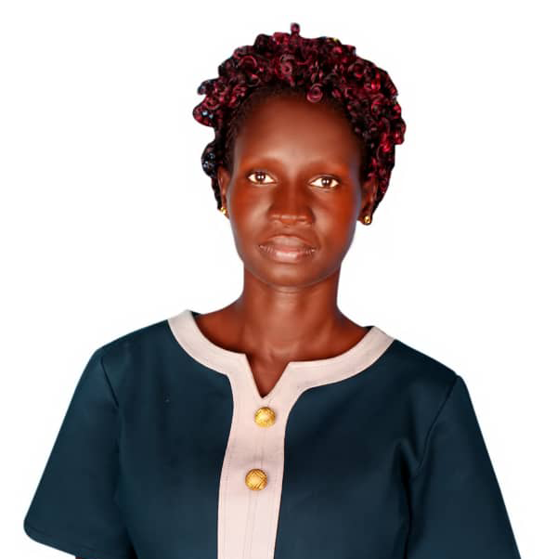
BLESSED ORGANIC
Team
Margaret Laloyo
Okot Joachim
Jenneth Laker
Apio Elisabeth Isaac
Director
IT Internal Control
System Manager
Business Development
Manager
Certified Experts in Shea Butter
Finance and Admin

Slide 13

BLESSED ORGANIC
Contact Information
Oyutu village, Luna Parish,Pader TC, Pader District
Website
www.blessedorganic.org
:
:
Address
Pader Town Council, Pader District, Uganda, East Africa.
Email
organicblessed87@gmail.com
:
+256 772 312 677

